Slide 1
FarFesh
فرفش
JUMANA SULTAN, University of Petra, jumanasultan@hotmail.com, Jordan
ABDELRAHMAN AL HARAHSHEH
PAULA DOZSA, NYU Abu Dhabi, pauladozsa@nyu.edu, UAE
ALAA SHAHEEN, Progineer Technologies, alaa.shaheen2012@gmail.com, Software Engineer
GEOFFREY LITT, Panorama Education, glitt@panoramaed.com, Software Engineer
AHMED ALI, Qatar Computing Research Institute: QCRI, amali@qf.org.qa, Sr. Software Engineer
HIEU HOANG, NYU Abu Dhabi, hh65@nyu.edu, Researcher

Slide 2
Why do we need FarFesh ?

Slide 3
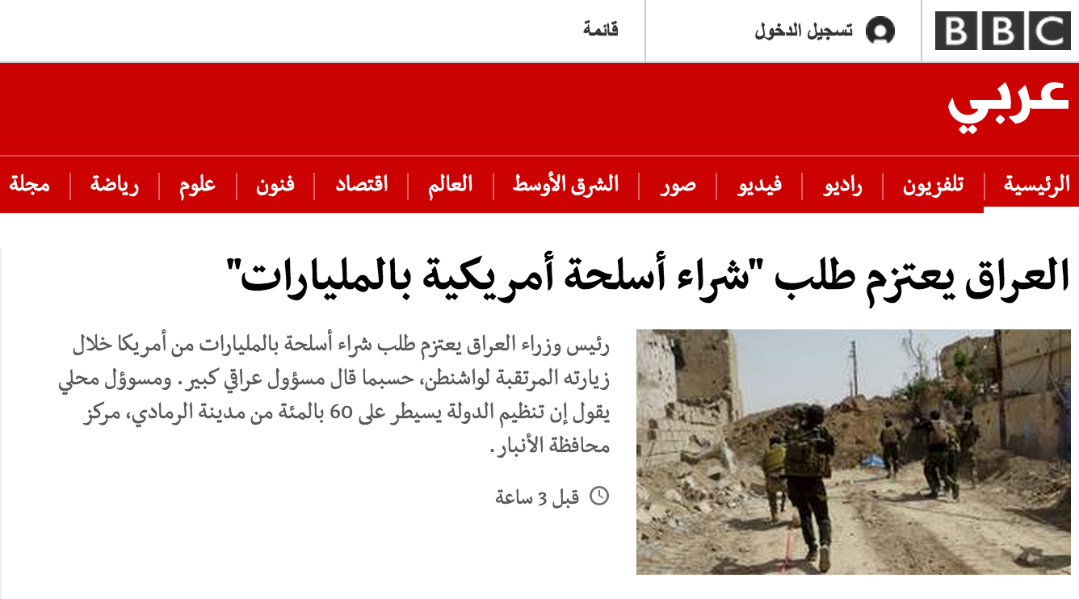
Why do we need FarFesh ?

Slide 4
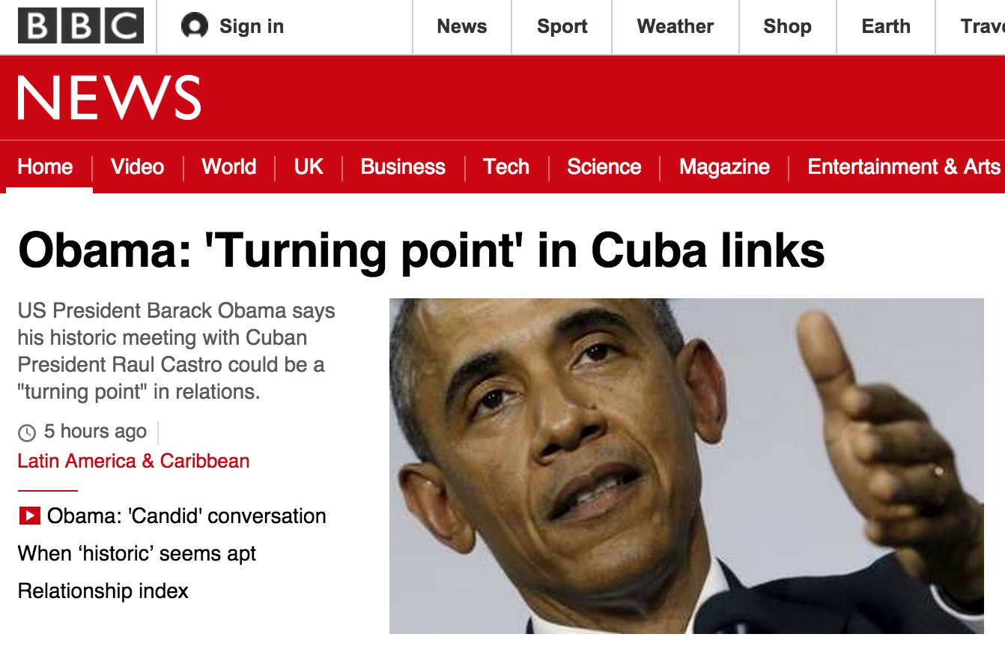
Why do we need FarFesh ?

Slide 5

Why do we need FarFesh ?

Slide 6
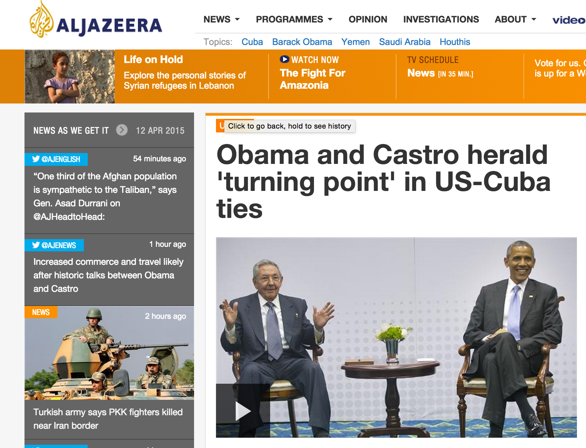
Why do we need FarFesh ?

Slide 7

Why do we need FarFesh ?

Slide 8

Why do we need FarFesh ?

Slide 9
Demo
http://farfesh.meteor.com

Slide 10


Slide 11
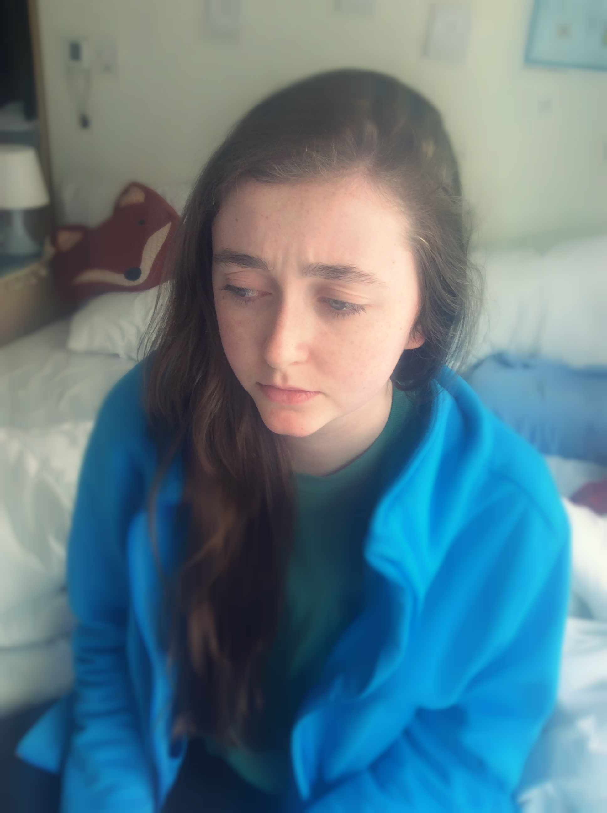

Slide 12
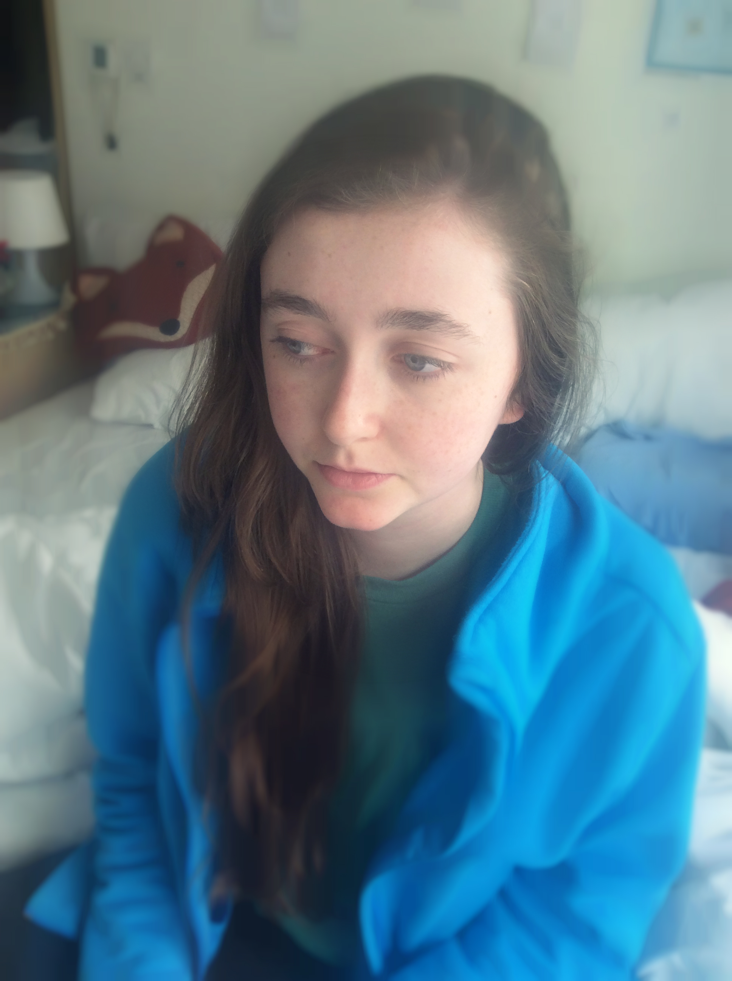

Slide 13
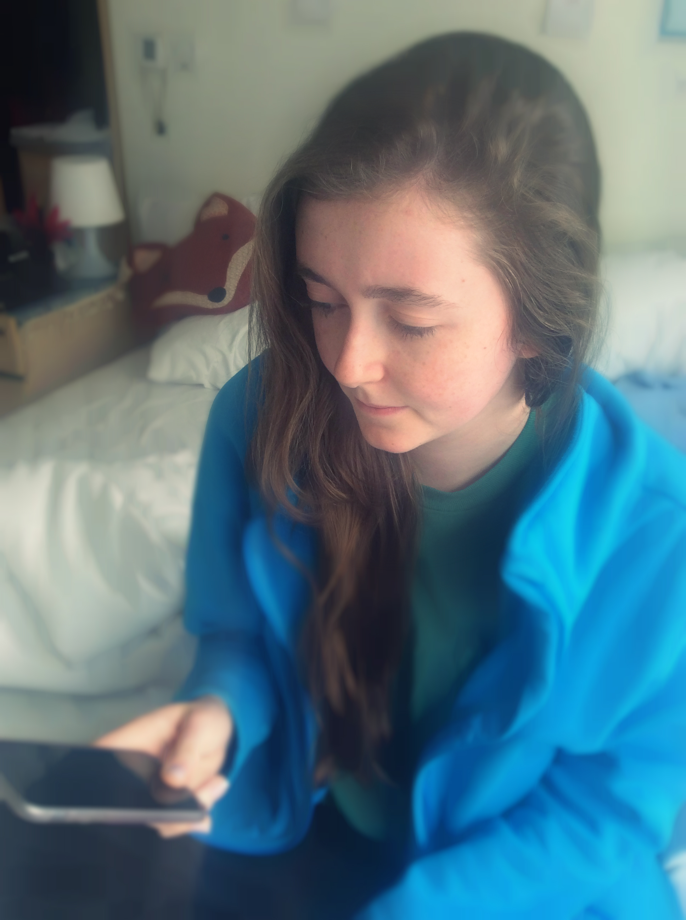

Slide 14
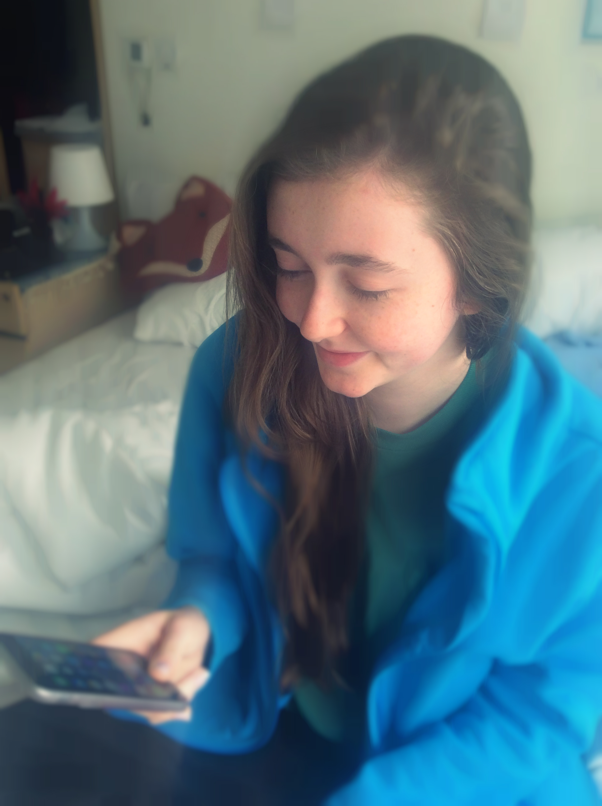

Slide 15
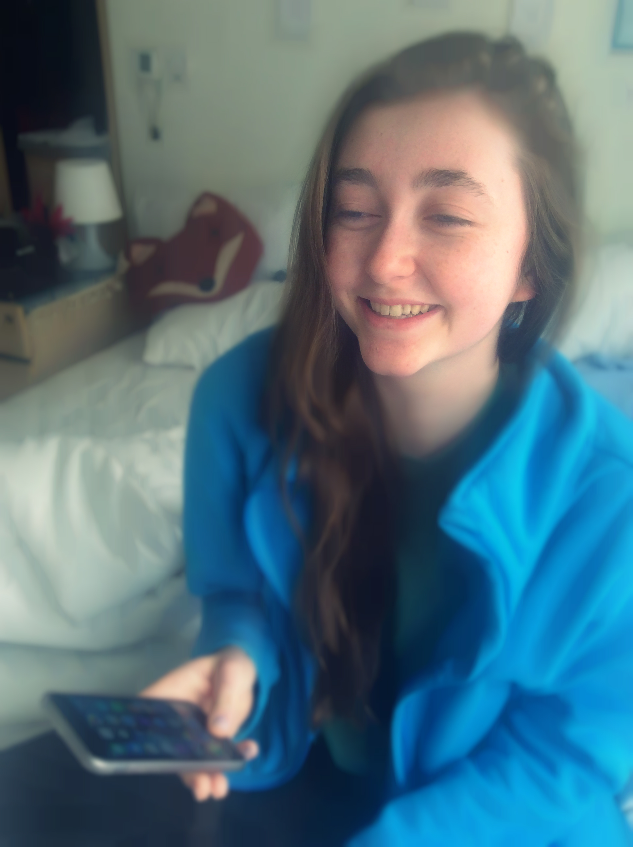

Slide 16
How willFarFesh help?
We are creating a constant feed of positive content
We are giving people a chance to share their happiness with others

Slide 17
Future Steps
Monetize by promoting happy events in the users’ locations
Allow users to log in and save their favorite stories
Expand number of languages
Give users the option to record stories
Optimize for iOS and Android

Slide 18
Happy FarFesh ing!

